Slide 2
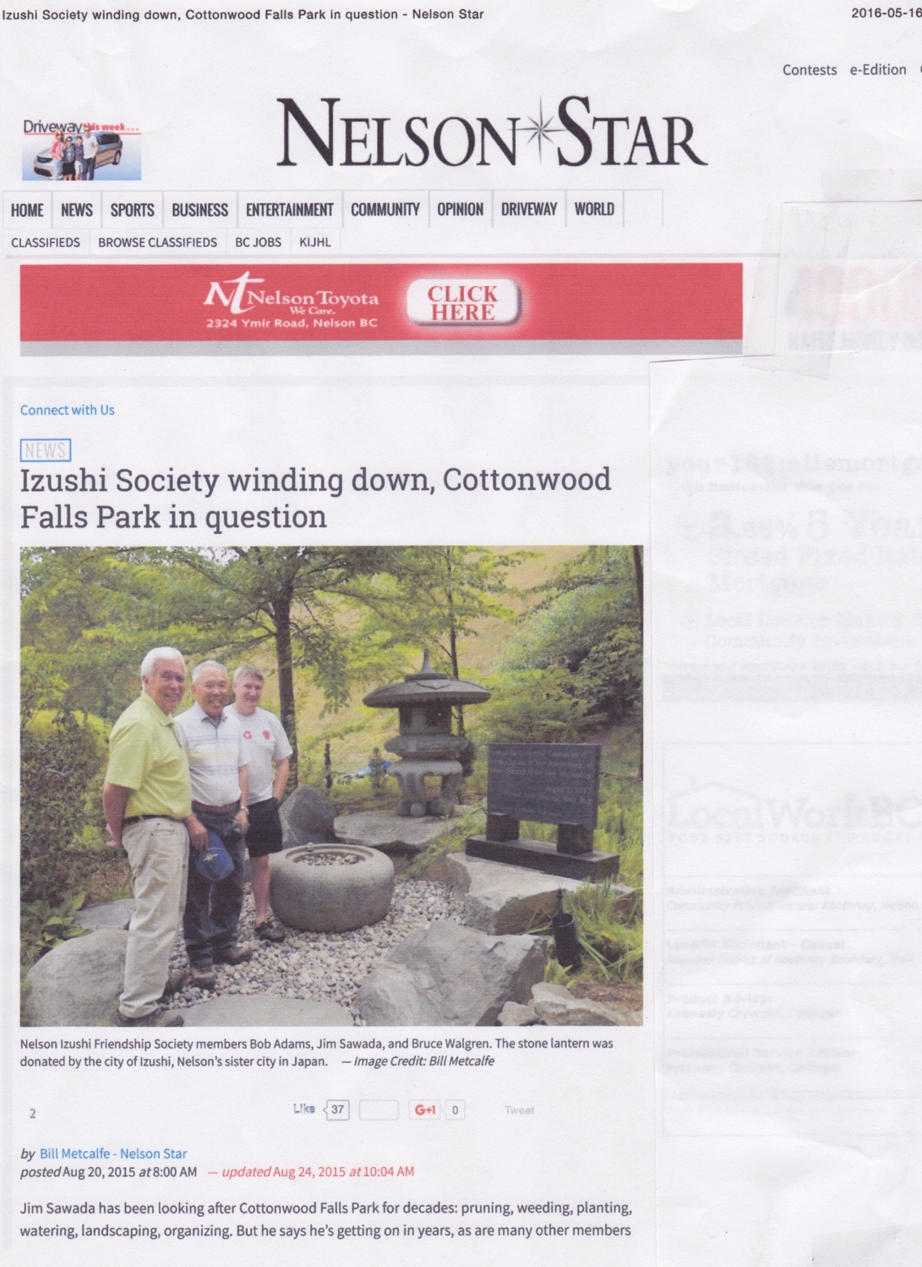

Slide 11
1987 – 2017
Celebrating 30 Years
as Sister Cities

Slide 21
Contacts
www.city.izu.shizuoka.jp
www.nelson.ca
www.nelsonizushi.com
nelsonizushi@gmail.com

